Slide 1
For Live Session Assignment (FLS)
Unit 11

Slide 2
Quick Quiz Questions

Slide 3
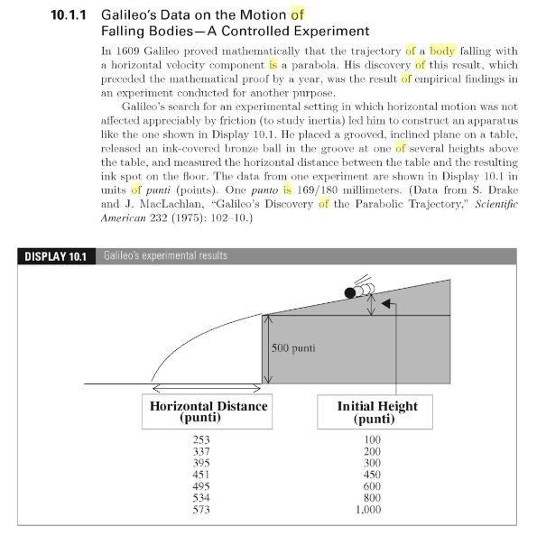
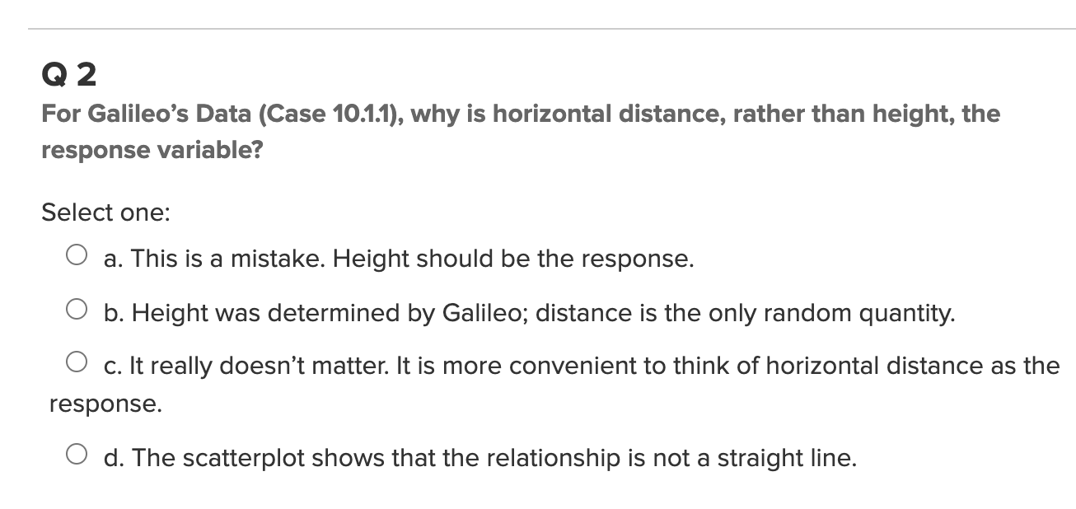
Part 1: Quick Quiz Questions

Slide 4
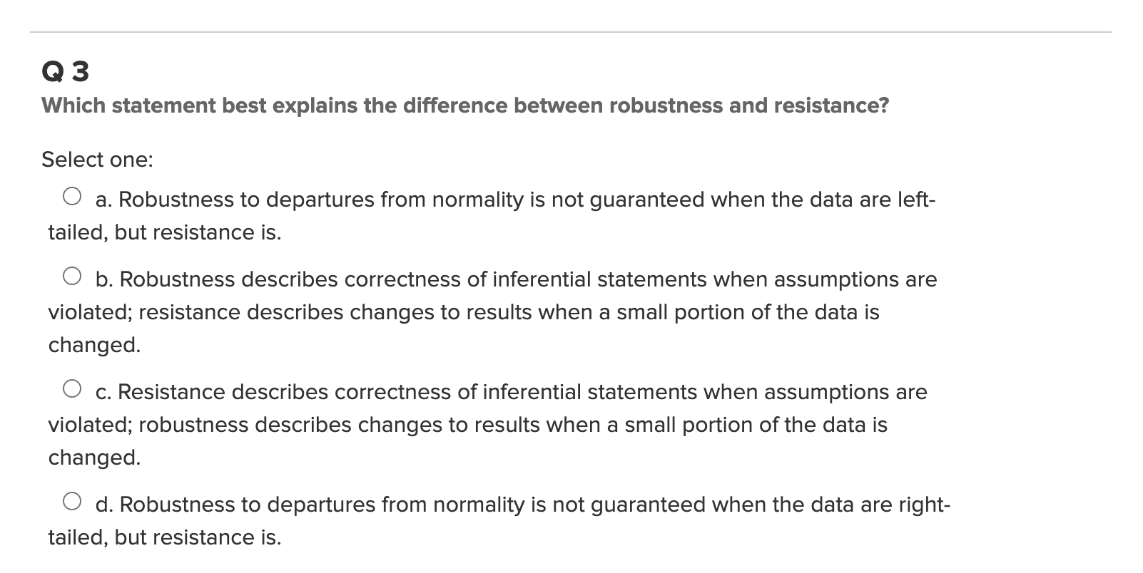
Part 1: Quick Quiz Questions
Review: Blast from the past!

Slide 5
End Quick Quiz Questions

Slide 6


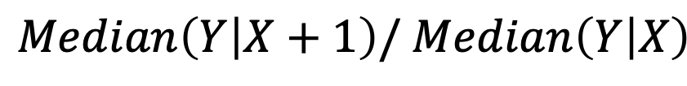
Log Transforms: Log-Linear
$$Median\left(Y | X+1\right)/ Median\left(Y | X\right)$$
$${=e}^{β_{1}}$$
Interpretation: A one unit increase in X is associated with a multiplicative change of $e^{β_{1}}$ in Median(Y|X).
** Note: We use a base of e for $e^{β_{1}}$ because the base on the log function was implied to be e. (Other bases could be interchanged.)

Slide 7
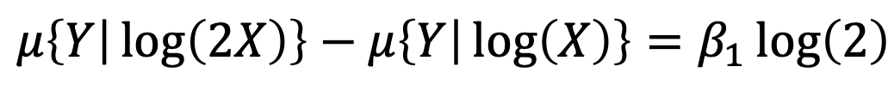

Log Transforms: Linear-Log (cont.)
$$μ\left\{Y | \log\left(2X\right)\right\}−μ\left\{Y | \log\left(X\right)\right\}=β_{1}\log\left(2\right)$$
Interpretation: A doubling of X is associated with a $β_{1}l$og(2) unit change in the mean of Y.

Slide 8
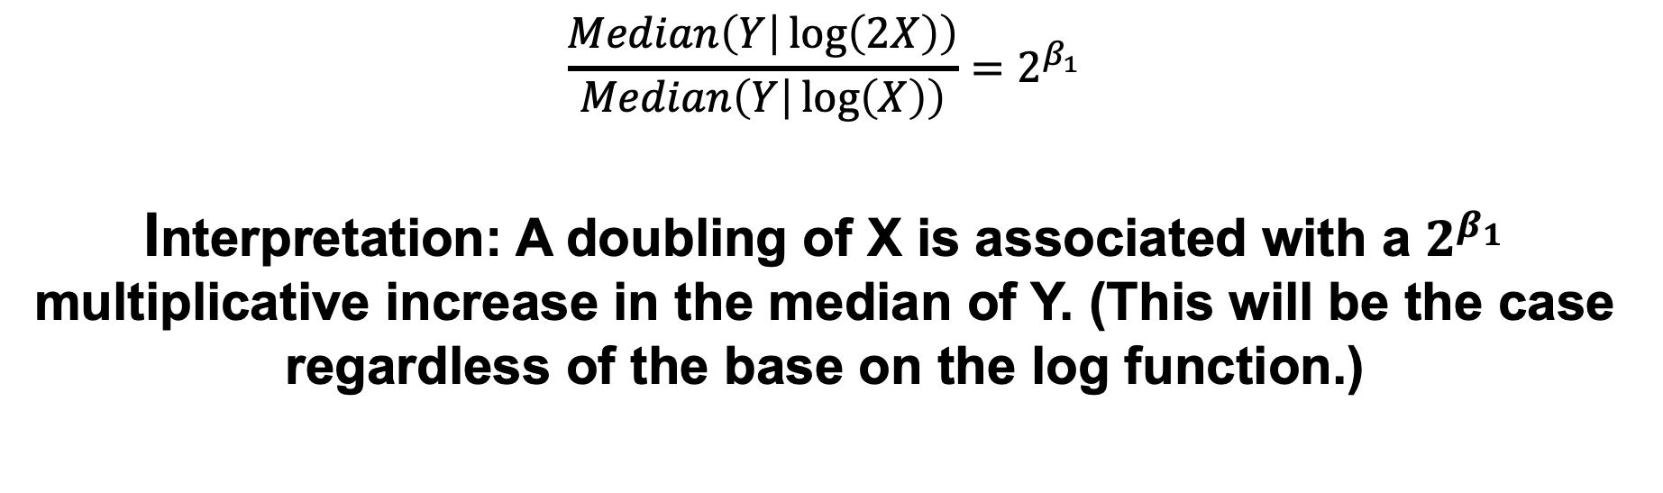
Interpretation Log-Log Model
$$\frac{Median\left(Y | \log\left(2X\right)\right)}{Median\left(Y | \log\left(X\right)\right)}=2^{β_{1}}$$
Interpretation: A doubling of X is associated with a $2^{β_{1}}$ multiplicative increase in the median of Y. (This will be the case regardless of the base on the log function.)

Slide 9
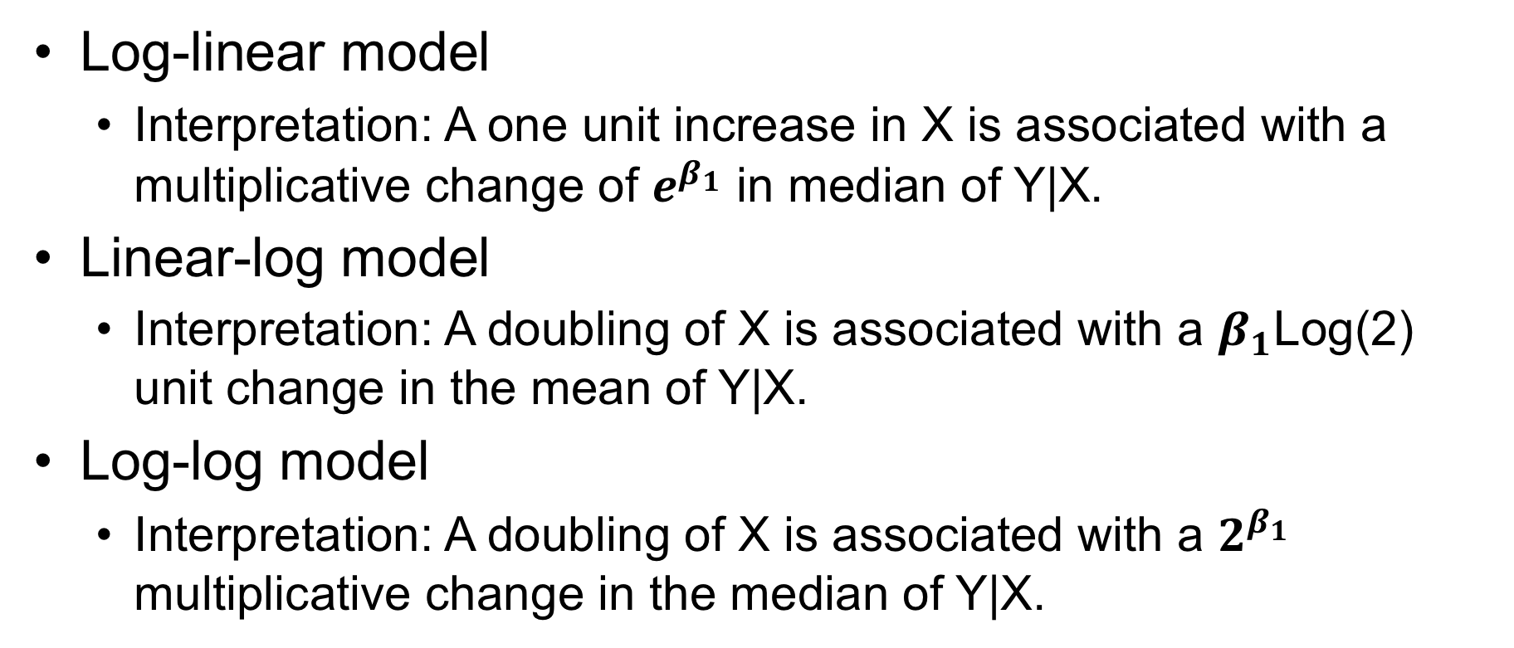
Summary
Log-linear model
Interpretation: A one unit increase in X is associated with a multiplicative change of $e^{β_{1}}$ in median of Y|X.
Linear-log model
Interpretation: A doubling of X is associated with a $β_{1}$Log(2) unit change in the mean of Y|X.
Log-log model
Interpretation: A doubling of X is associated with a $2^{β_{1}}$ multiplicative change in the median of Y|X.

Slide 10
Question 1

Slide 11
Infant Mortality versus GDP
A hugely impactful issue around the world is that of the infant mortality rate.
We would like to conduct a study of infant mortality versus GDP.
Turns out the World Bank keeps this data … and … as you know (or will know after DDS)… they have an API available through R! (package WDI).
I have provided the code (on the next slide), but please dissect the code to pick up and/or polish a data ingestion and wrangling skill!
Use the resulting dataset to plot Infant mortality rate (Y) versus GDP (X).
Does it look like there is a linear relationship?
If there does not appear to be a linear relationship, research if a log transform of one or both variables will be helpful in conducting a linear regression.
If you were able to find a reasonable transformation, fit a simple linear regression line to the data and show the plot.
Find the GDP of the United States of America and report if the actual infant mortality rate is above or below the amount expected by the regression line. This line can be interpreted as the average Infant mortality rate after adjusting for GDP (you might here it in the news reported in this fashion.)
Finally, we would like to try and quantify the relationship between Infant Mortality and GDP. Interpret the slope of the regression line on the original scale (not on the log scale).
Be sure to quantify the uncertainty by including a confidence interval.
The code is on the next sllde! Have fun!

Slide 12
OLD: Infant Mortality versus GDP: R Code
What is the problem?
install.packages(“WDI”)
library(tidyverse)
library(WDI)
WDIsearch("infant") # yields the indicator: SP.DYN.IMRT.IN
WDIsearch("GDP") # yields the indicator: NY.GDP.PCAP.CD
InfantMort = WDI(,"SP.DYN.IMRT.IN",start = 2019, end = 2019)
GDPs = WDI(,"NY.GDP.PCAP.CD",start = 2019, end = 2019)
InfantVGDP = inner_join(GDPs,InfantMort,"country")
InfantVGDP = InfantVGDP[,c(1,2,3,4,6)]
colnames(InfantVGDP) = c("iso2C","country","GDP","year","InfantMort")
InfantVGDP

Slide 13
New: Infant Mortality versus GDP: R Code
What is the fix?
install.packages("WDI")
library(WDI)
WDIsearch("infant") # yields the indicator: SP.DYN.IMRT.IN
WDIsearch("GDP") # yields the indicator: NY.GDP.PCAP.CD
InfantMort = WDI(,"SP.DYN.IMRT.IN",start = 2019, end = 2019)
GDPs = WDI(,"NY.GDP.PCAP.CD",start = 2019, end = 2019)
InfantVGDP = inner_join(GDPs,InfantMort, "country")
InfantVGDP = InfantVGDP %>% select("country","NY.GDP.PCAP.CD","SP.DYN.IMRT.IN")
colnames(InfantVGDP) = c("country","GDP","InfantMort")
InfantVGDP
# Note: The code above depends on the World Bank keeping the format with which they present the data.
# If you run into an error, please first try and print out the results along the way to see
# if you can figure out how to fix it. If after 30 min to an hour it is still a problem, feel free to reach
# out and I will find a solution.
# You can do it though! ☺

Slide 14
End Question 1

Slide 15
Question 2

Slide 16
Lack of Fit Test
A company wants to look at sales volume (in $M) for various stores for three different months. Perform a lack of fit test (at significance level 0.05) to determine if the separate means model (using three parameters) is significantly better than the linear regression model (using two parameters).
You may want to copy the blank ANOVA table on paper.
DO NOT plug the data into any software. ☺
Month | Sales
1 | 2.678969
1 | 6.452194
1 | 1.837394
1 | 6.108601
1 | 5.369281
2 | 1.766862
2 | 6.898837
2 | 1.579677
2 | 3.726494
2 | 8.953184
3 | 8.680436
3 | 9.931636
3 | 6.691443
3 | 11.39723
3 | 14.93447
Source | df | SS | MS | F | Pr > F

Slide 17
End Question 2

Slide 18
Question 2: Takeaways!
Please provide at least 4 takeaways from this section and any questions that you may have. These questions will help design the live session for this unit.
This question will be the last question of every For Live Session Assignment. The idea is that this deck will serve as a document that you can reference in the future to remember what was covered in this section. For instance, this may come in handy for the Capstone and will hopefully become useful in your career. Most immediately, it may become handy as a quick reference for your Midterm and Final! Some students find it very useful and spend a few slides summarizing the asynch material while others learn different ways and only had the minimum 4 takeaways. Either is fine and will earn you full credit for this question.

Slide 19
Question 3: Questions!
Please provide any question or topics of discussion that came up in this Unit! These will help help us optimize our live session for maximum learning and takeaways!
This question will be the last question of every For Live Session Assignment. The idea is that this deck will serve as a document that you can reference in the future to remember what was covered in this section. For instance, this may come in handy for the Capstone and will hopefully become useful in your career. Most immediately, it may become handy as a quick reference for your Midterm and Final! Some students find it very useful and spend a few slides summarizing the asynch material while others learn different ways and only had the minimum 4 takeaways. Either is fine and will earn you full credit for this question.

Slide 20
End For Live Session Assignment Unit 9!

